Slide 1

Online Course Completion Prediction System
Based on Student Learning Activities and Engagement Metrics
LEARNING ANALYTICS · MACHINE LEARNING · STUDENT SUCCESS

Slide 2

The Challenge in Modern Online Education
Online learning has scaled globally, yet dropout rates remain critically high. Traditional monitoring relies on manual observation and final assessments — making early intervention nearly impossible.
High Dropout Rates
Late Intervention
MOOCs report completion rates as low as 5–15%, leaving millions of learners without credentials.
Manual monitoring detects risk too late — often only after final assessments reveal failure.
Fragmented Data
Learning activity data exists in silos across LMS platforms, rarely unified for predictive analysis.

Slide 3

Proposed Solution: Intelligent Completion Prediction
The system continuously analyses student engagement signals to predict course completion probability and assign risk scores — enabling instructors to intervene before learners disengage.
What the System Does
Collects real-time learning activity data across multiple engagement dimensions
Engineers behavioural and temporal features from raw interaction logs
Runs ML inference to generate completion probability scores
Flags at-risk learners and recommends personalised interventions
Provides instructors with an actionable, real-time analytics dashboard

Slide 4




Student Engagement Metrics & Feature Engineering
The model ingests ten categories of behavioural signals, transformed through feature engineering into predictive inputs.
Access & Consistency
Content Engagement
Login frequency, study duration, and learning consistency patterns
Video viewing time, course progress percentage, and module completion rate
Assessment Activity
Social Interaction
Assignment submissions, quiz scores, and attempt frequency
Forum participation, peer responses, and collaborative engagement

Slide 5
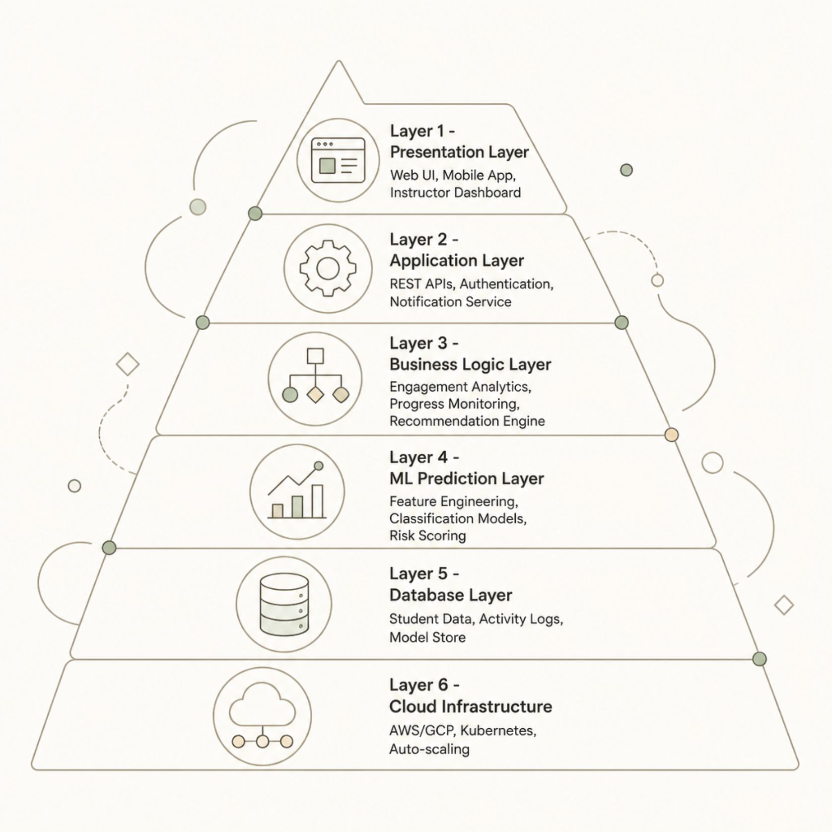
System Architecture
A six-layer architecture ensures secure, scalable, and intelligent processing of learning data from ingestion to actionable insight.
Key Architectural Principles
Microservices-based design for independent scaling of ML and analytics components
RESTful APIs for seamless LMS integration and third-party data ingestion
Cloud-native deployment on AWS or GCP with Kubernetes orchestration
Role-based access control across student, instructor, and admin tiers

Slide 6

End-to-End Workflow
Inference & Scoring
Data Collection
Preprocessing
The pipeline operates continuously — new activity data triggers incremental re-scoring, and model performance is monitored with automated retraining cycles to maintain accuracy across diverse learner populations.

Slide 7

Machine Learning Pipeline & Algorithms
ML Development Lifecycle
Algorithms & Evaluation
Dataset Collection: Historical LMS logs, enrolment records, and assessment data
Preprocessing: Missing value imputation, outlier handling, and normalisation
Feature Selection: Correlation analysis, PCA, and recursive feature elimination
Model Training: Cross-validation, hyperparameter tuning via GridSearchCV
Deployment & Retraining: CI/CD pipelines with drift detection and scheduled retraining
Logistic Regression, Decision Trees, Random Forest
SVM, Gradient Boosting, XGBoost, LightGBM
Neural Networks and ensemble methods
Key Metrics: Accuracy, Precision, Recall, F1-Score, ROC-AUC, Sensitivity, Specificity, and Prediction Confidence

Slide 8





Technology Stack
A modern, open-source stack delivers a secure, scalable, and high-performance learning analytics platform.
Frontend
Backend
Data Layer
React.js / Angular, D3.js, Chart.js, responsive dashboards
Python (Flask / FastAPI), Node.js, REST APIs, JWT authentication
PostgreSQL, MongoDB, Redis cache, Apache Kafka for streaming
ML Stack
Cloud & DevOps
Scikit-learn, XGBoost, TensorFlow / PyTorch, MLflow for tracking
AWS / GCP, Docker, Kubernetes, CI/CD pipelines, Terraform

Slide 9



Key Advantages & Real-World Applications
Early At-Risk Identification
Detect disengagement weeks before failure, enabling proactive academic support.
Improved Completion Rates
Data-driven interventions measurably reduce dropout and improve credential attainment.
Scalable Across Institutions
Deployable across universities, MOOC providers, corporate training, and government programmes.
Personalised Learning Support
Tailored recommendations adapt to individual learner behaviour and pace.

Slide 10

Challenges, Future Enhancements & Conclusion
Implementation Challenges
Future Enhancements
Data Privacy: GDPR/FERPA compliance via anonymisation and consent management
Prediction Bias: Fairness audits and balanced training data across demographics
LMS Integration: Standardised LTI and xAPI connectors for multi-platform support
Incomplete Data: Imputation strategies and confidence-weighted predictions
Deep learning and explainable AI (XAI) for transparent predictions
Adaptive learning pathways and real-time intervention systems
Emotion detection and multimodal learning analytics
AI-powered intelligent tutoring and chatbot-based academic assistance
Conclusion: This system leverages ML and learning analytics to predict completion, identify at-risk learners early, and deliver scalable, personalised education at scale.

